Slide 1
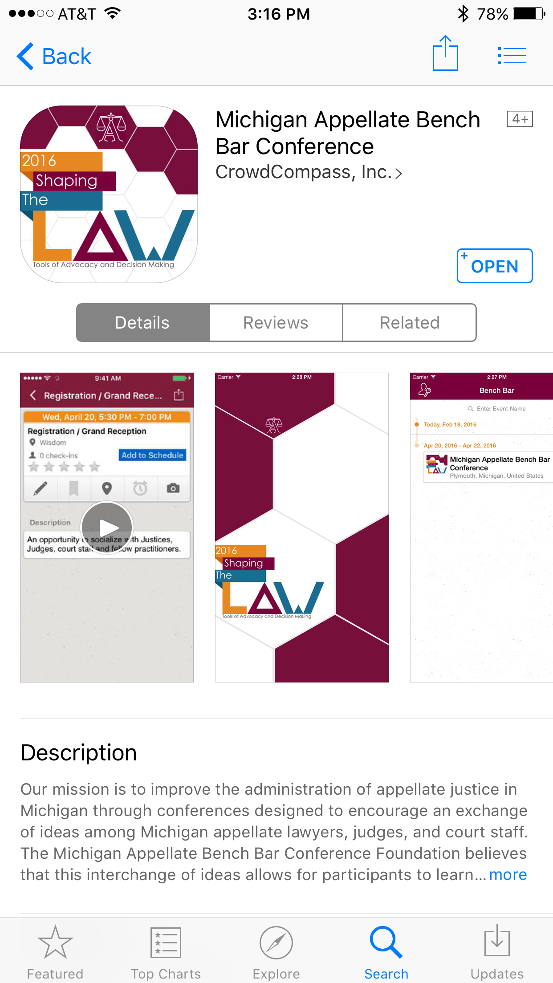
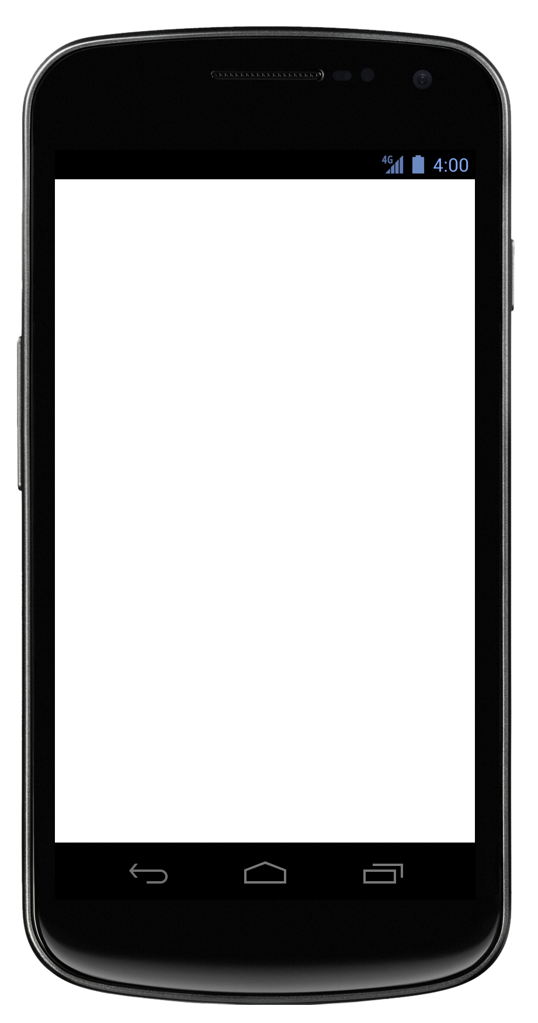
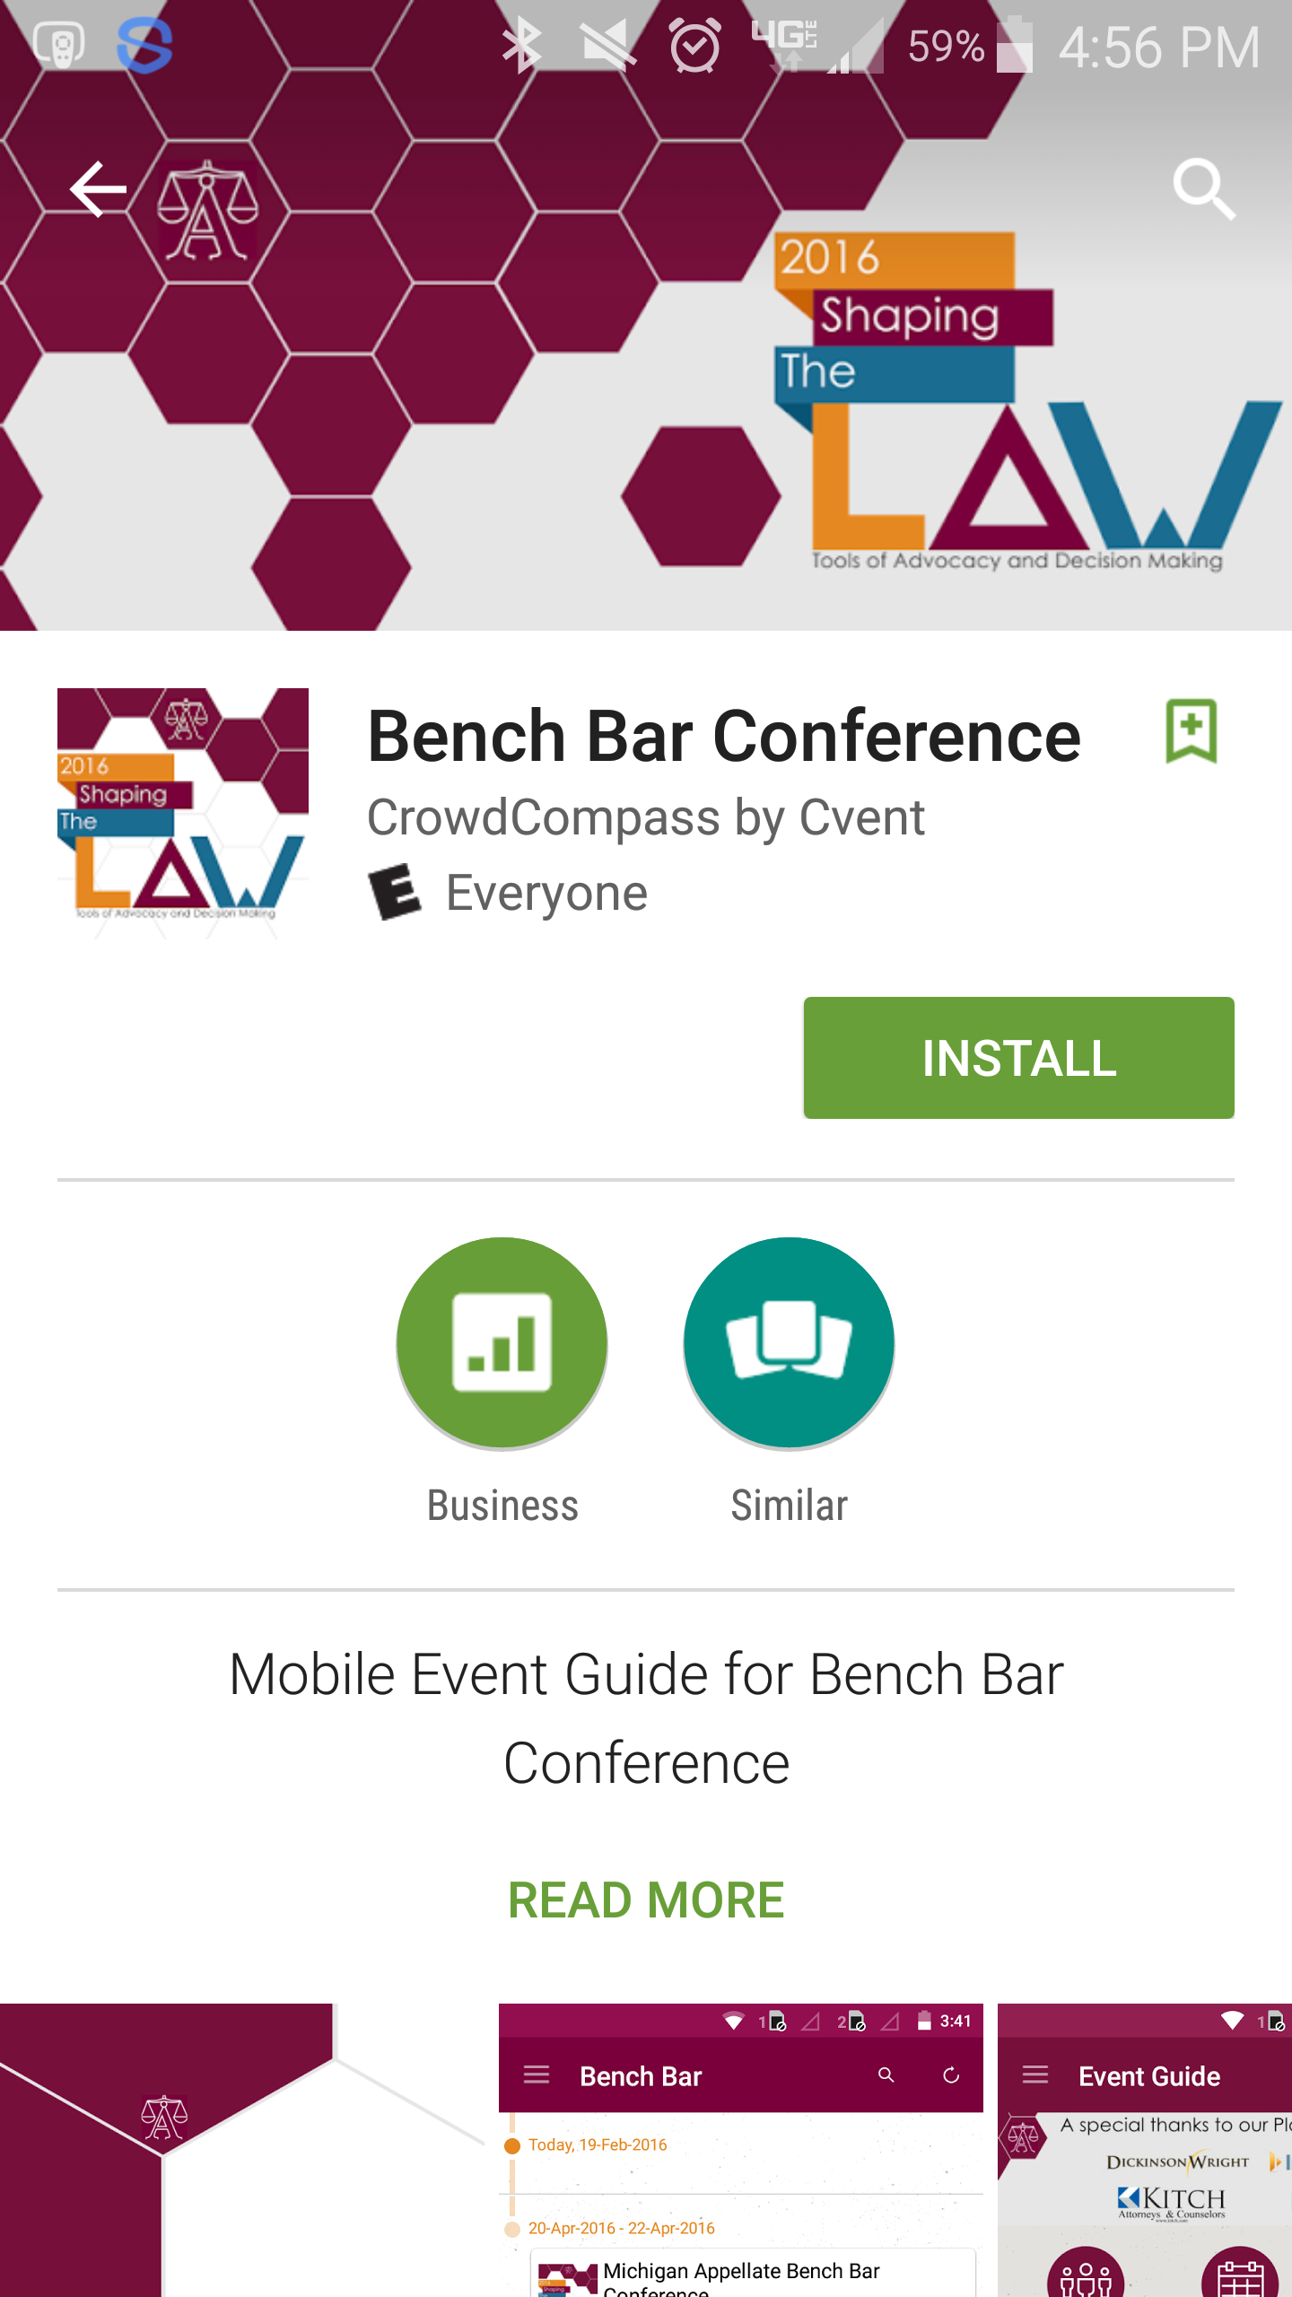
Downloading the App
Get the app
1 Go to the right store. Access the App Store on iOS devices, the Play Store on Android, and https://events.crowdcompass.com for a web browser version.
2 Install the app. Search for the name of the event, the name of the app, or the organization hosting it. Once you’ve found the app, tap either Download or Install.
Name:
iOS: Michigan Appellate Bench Bar Conference
Android: Bench Bar Conference
After installing, a new icon will appear on the home screen.
Or check for updates
1 Go to the right store. Access the App Store on iOS devices and the Play Store on Android.
2 Check for updates. If you have an iOS device, tap the Updates tab and check the list to see if any updates are available for your app.
For an Android device, tap the hamburger icon, then My apps. Check to see if your app is listed under “Updates.” If it is, tap its name, then Update.

Slide 2
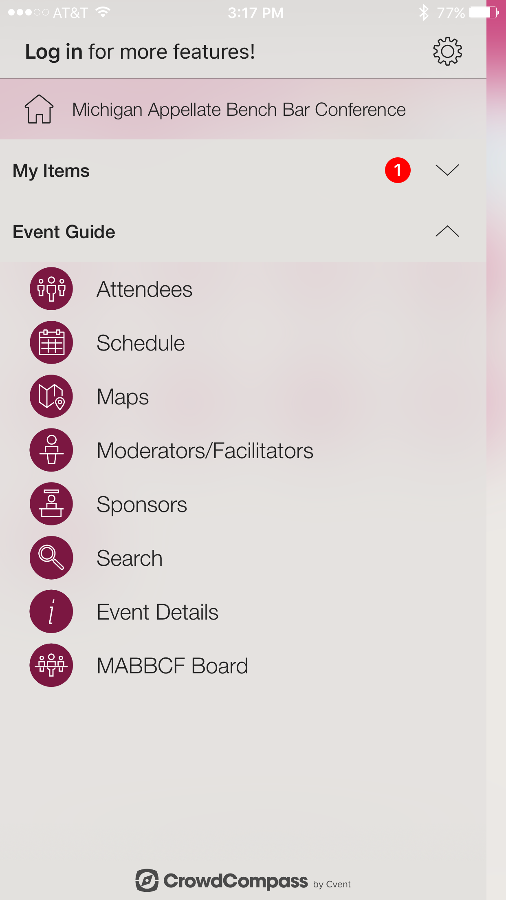
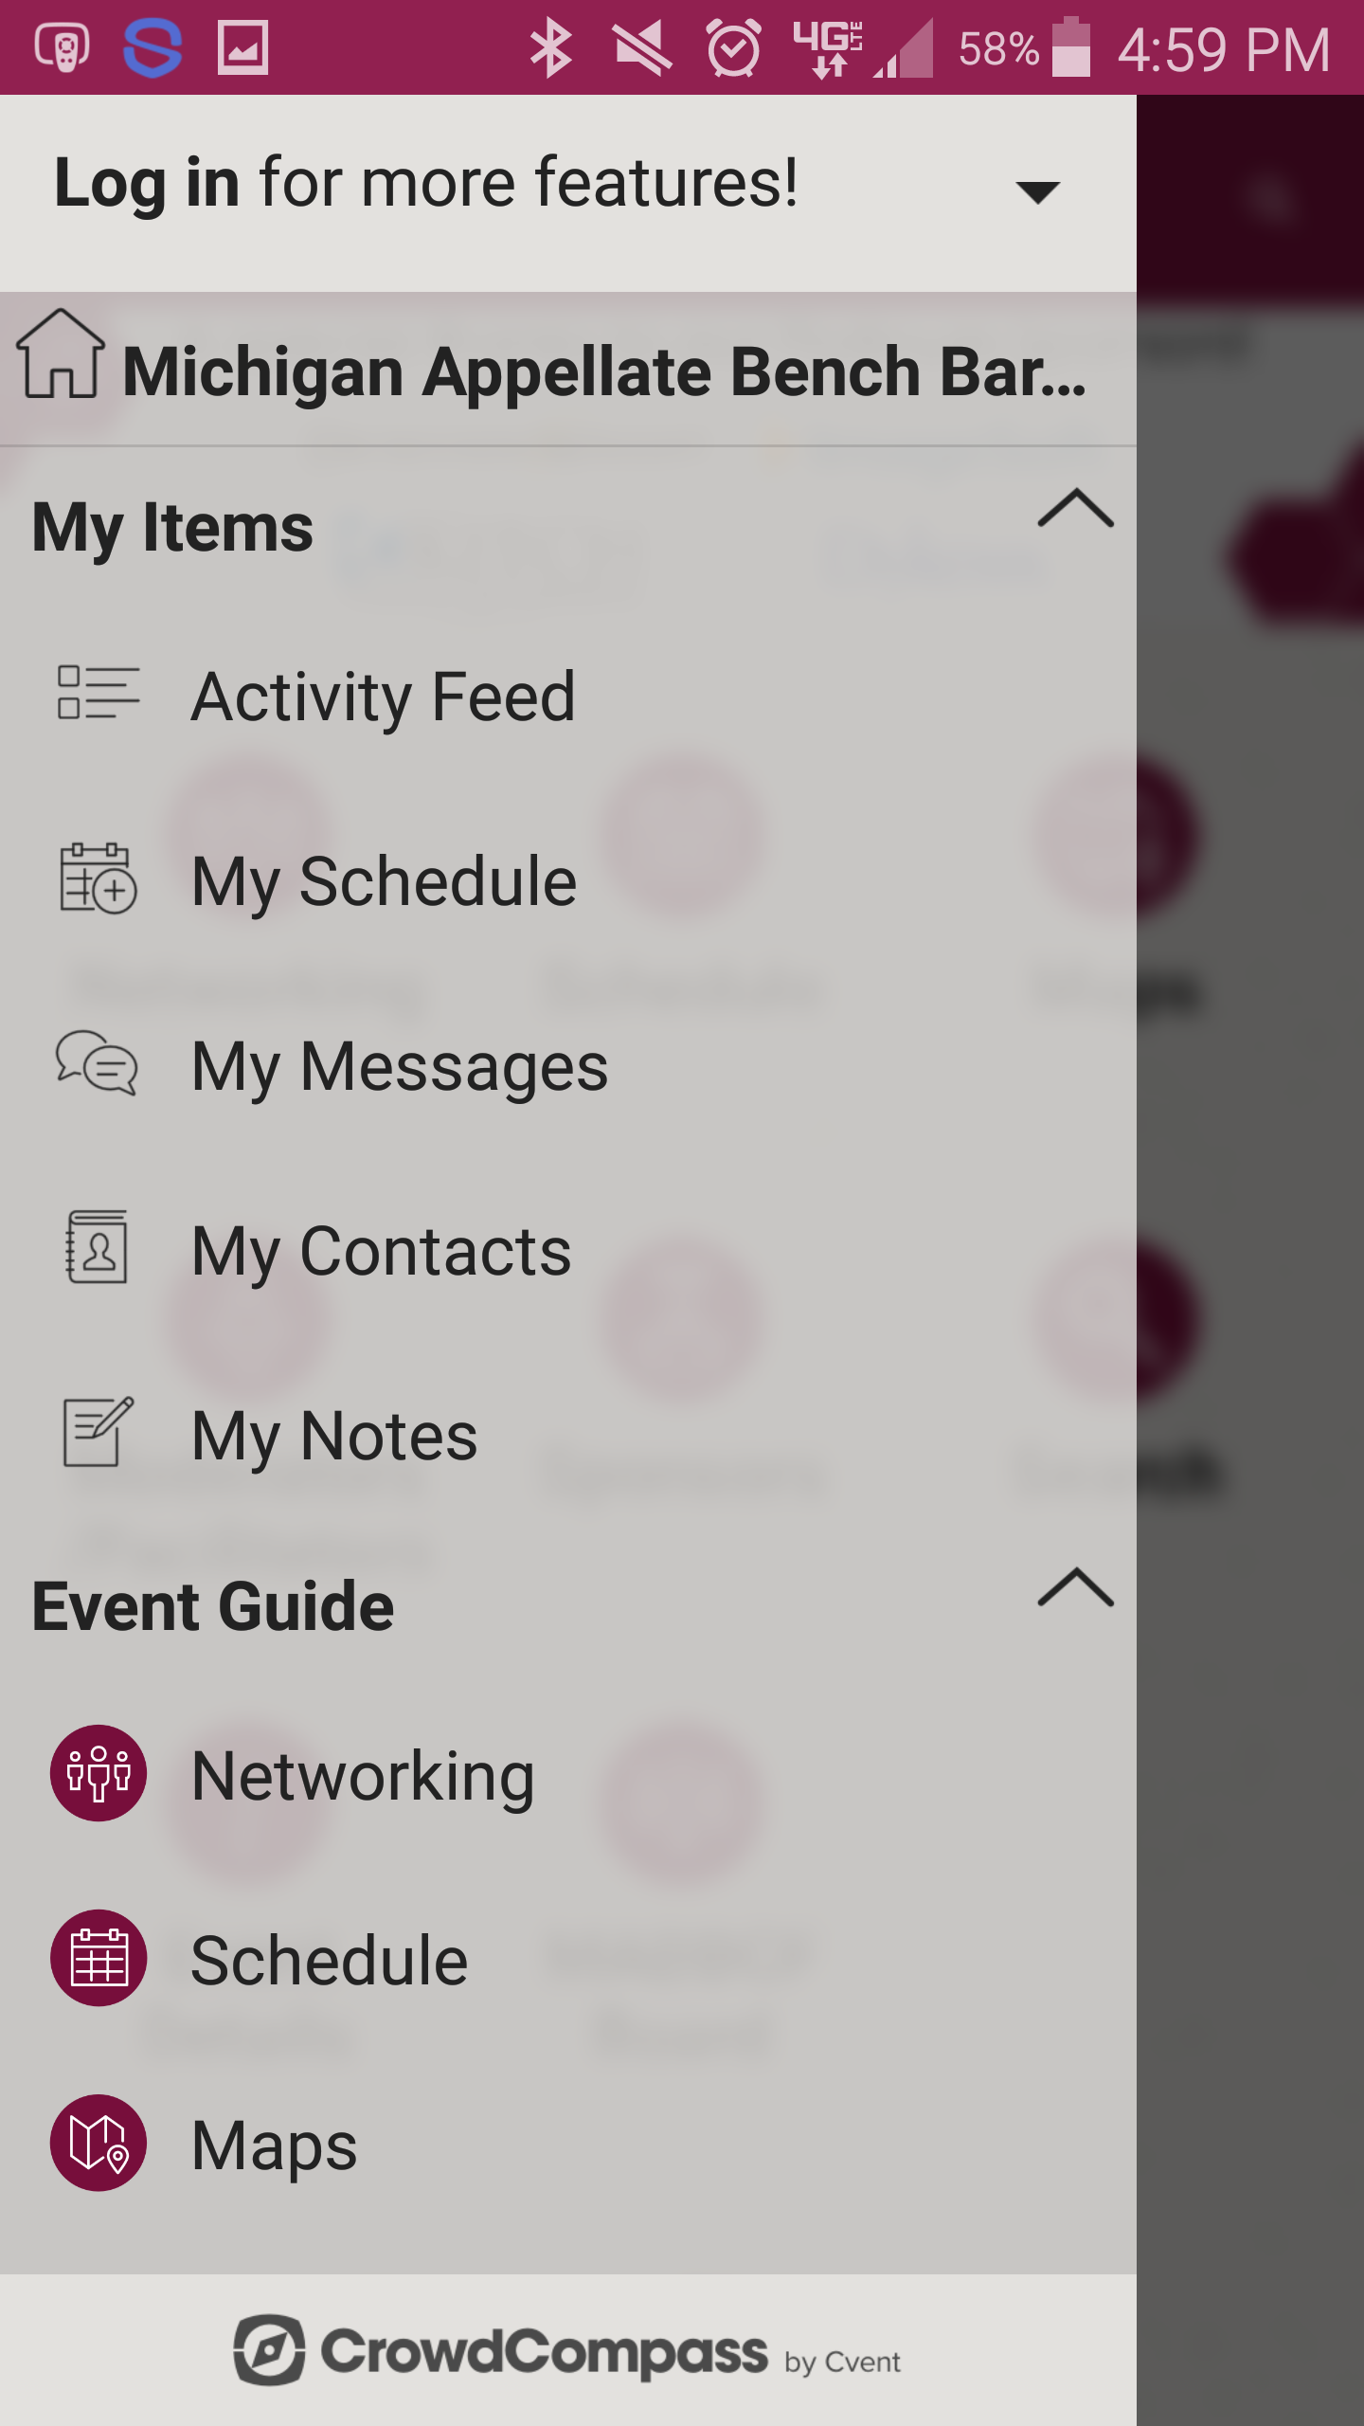
Logging In
Logging in on iOS
1 Access the Sign In page. Tap the hamburger icon in the upper-left corner, then the gear icon, then Log In.
2 Enter your reg code. You'll be prompted to enter your registration code, which is included in your invitation email. Enter it in the appropriate field, then enter either the email address where you received the invitation or your first and last name.
Once you’re ready, tap Log In.
Or Android
1 Access the Sign In page. Tap the hamburger icon in the upper-left corner, then Log In.
2 Enter your reg code. You’ll be prompted to enter your registration code, which is included in your invitation email. Enter it in the appropriate field, then enter either the email address where you received the invitation or your first and last name. Once you’re ready, tap Log In.

Slide 3
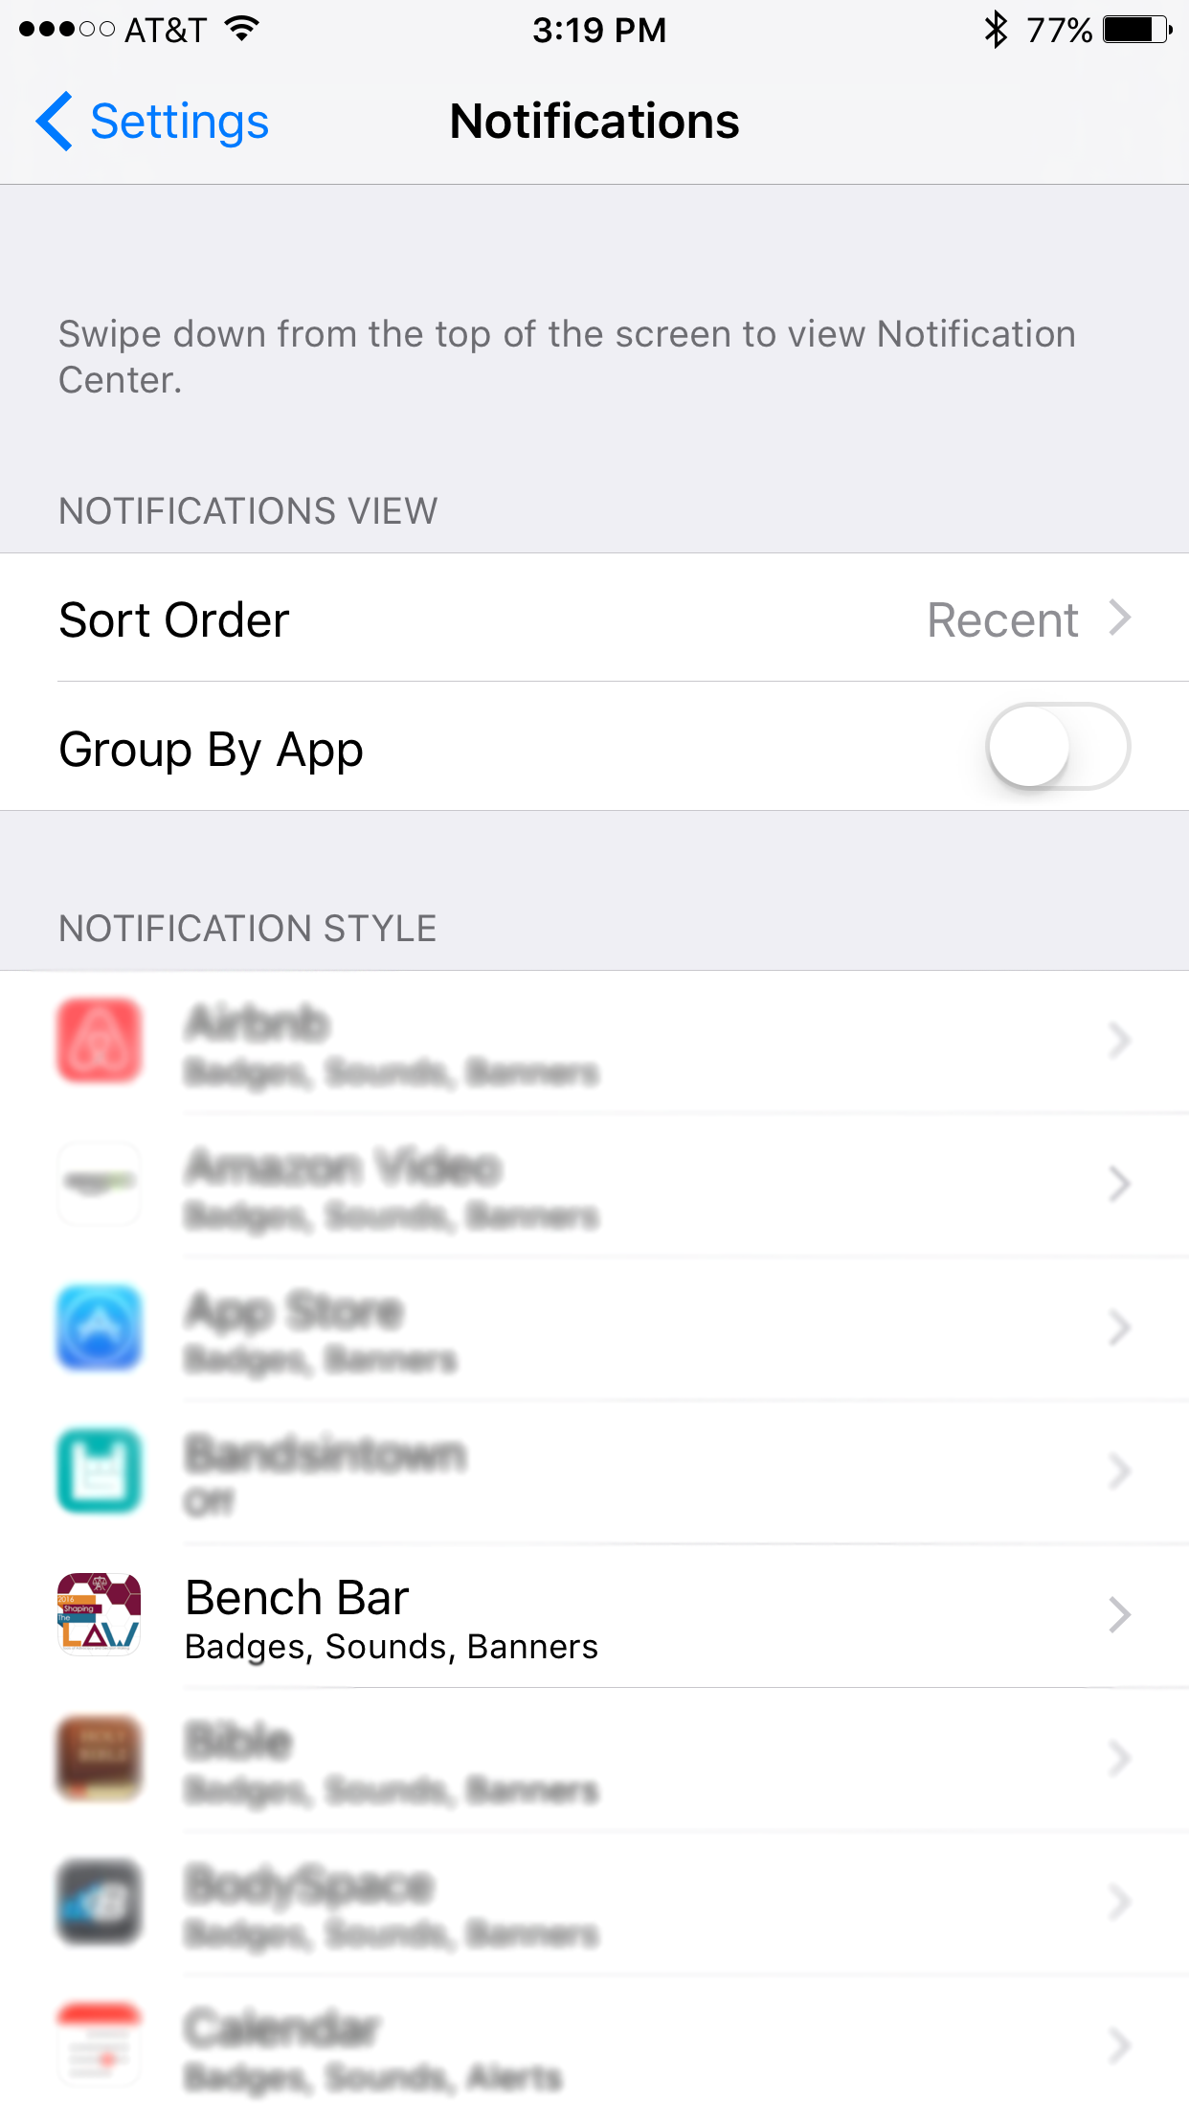
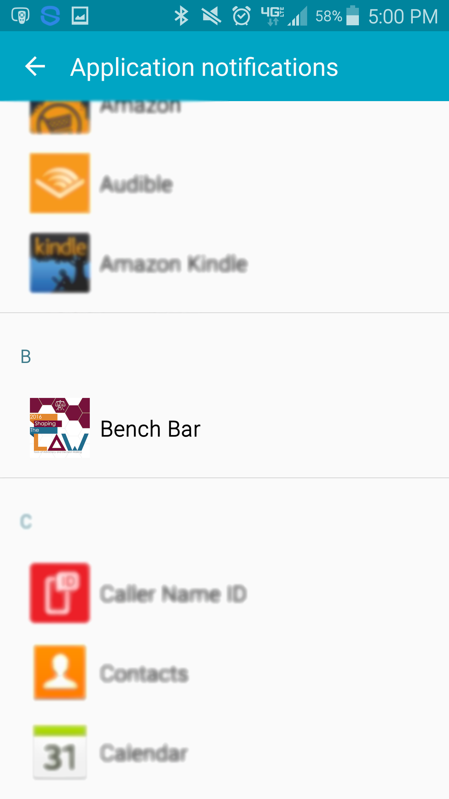
Allowing Push Notifications
Allowing Notifications on iOS
1 Access the Notifications menu. From the home screen, tap Settings, then Notifications.
2 Turn on Notifications for the app. Find the Michigan Appellate Bench Bar Conference app on the list and tap its name. Switch Allow Notifications on.
Or Android
Note: Not all Android phones are the same. The directions below walk you through the most common OS, Android 5.0.
1 Access the Notification menu. Swipe down on the home screen, then click the gear in the top right. Tap Sounds and notifications.
2 Turn on Notifications for your event’s App. Scroll down and tap App notifications. Find Bench Bar Conference app on the list. Switch notifications from off to on.

Slide 4
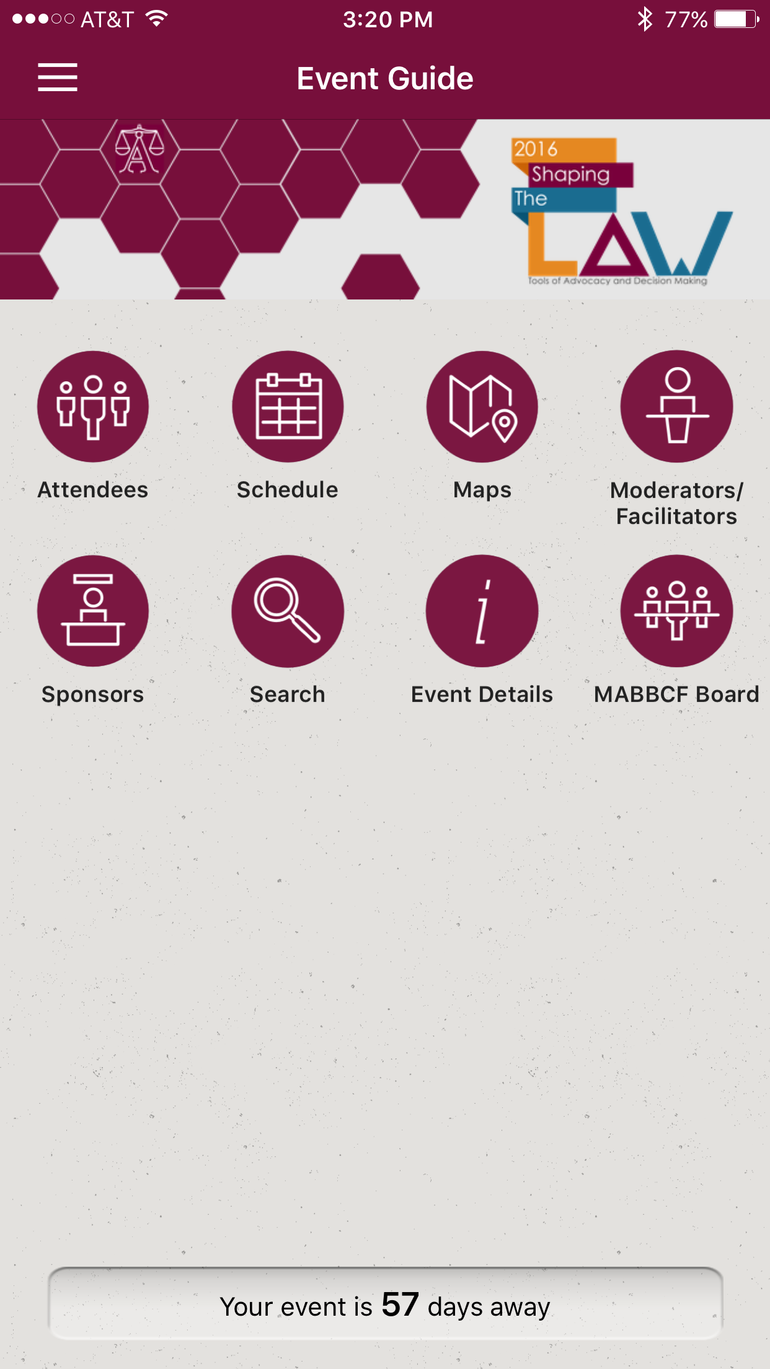
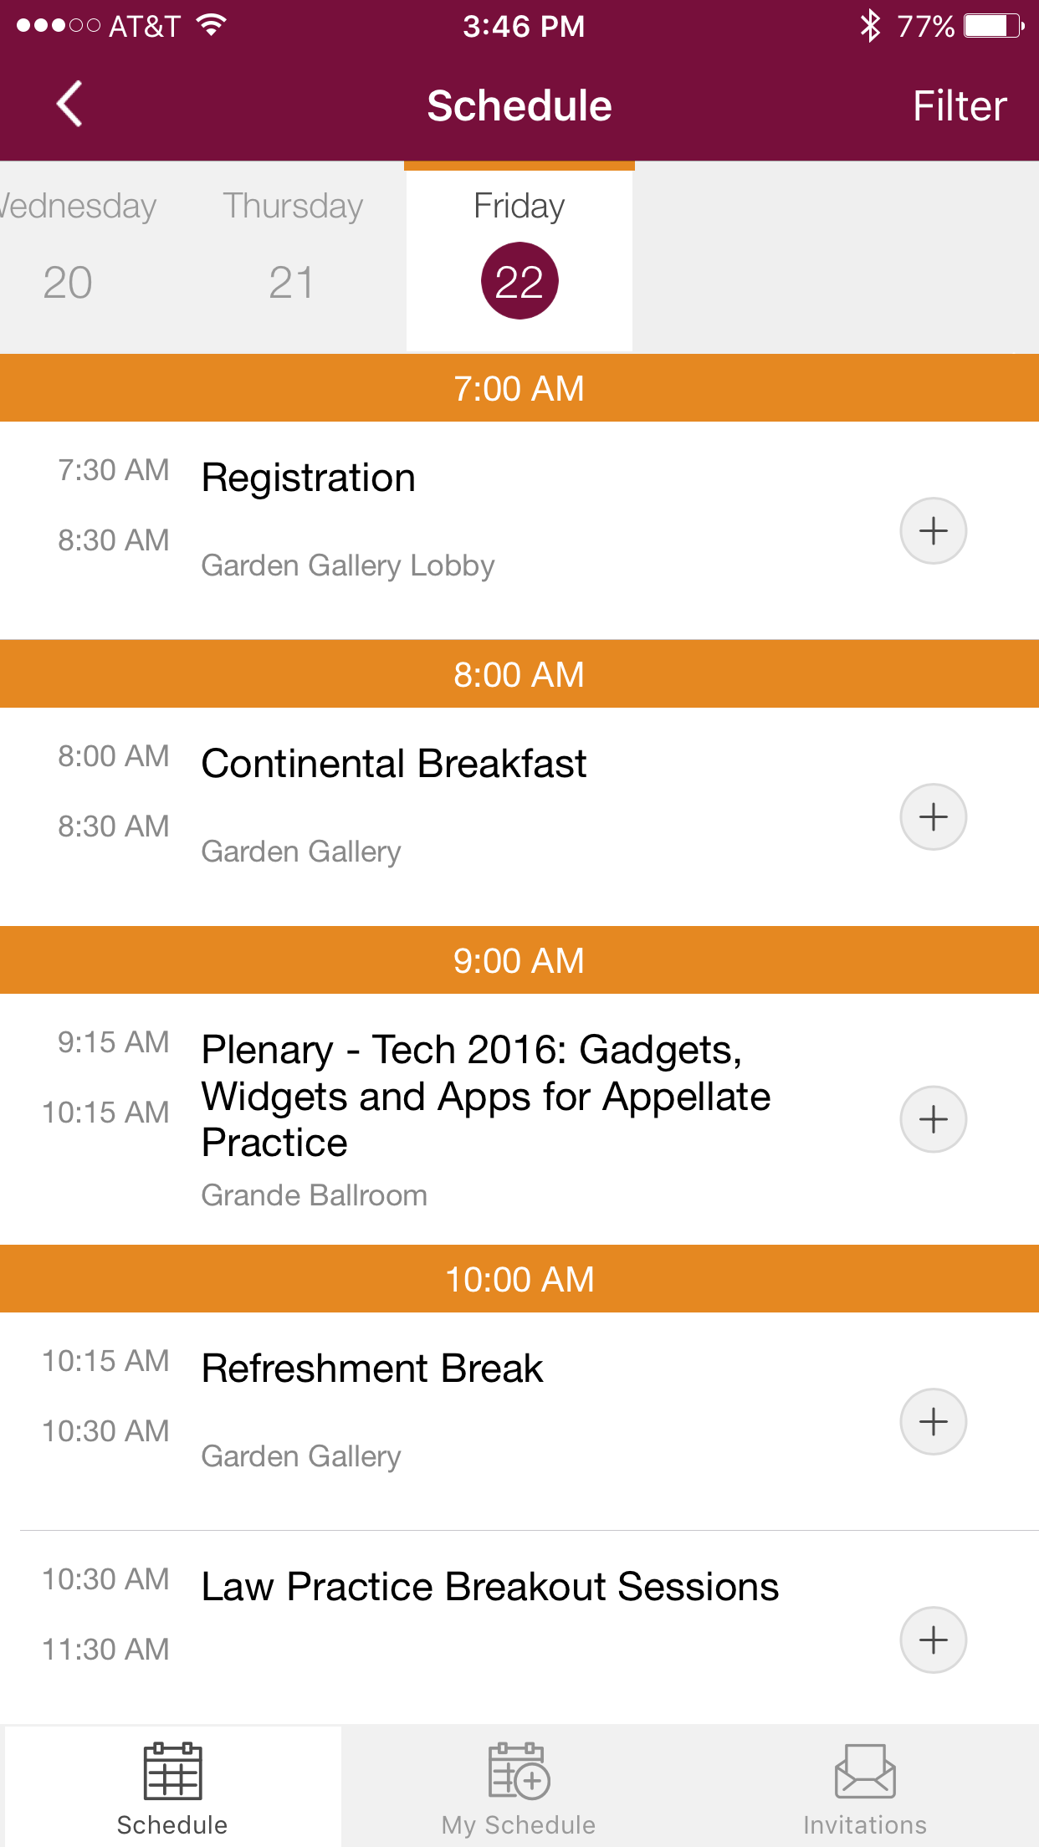
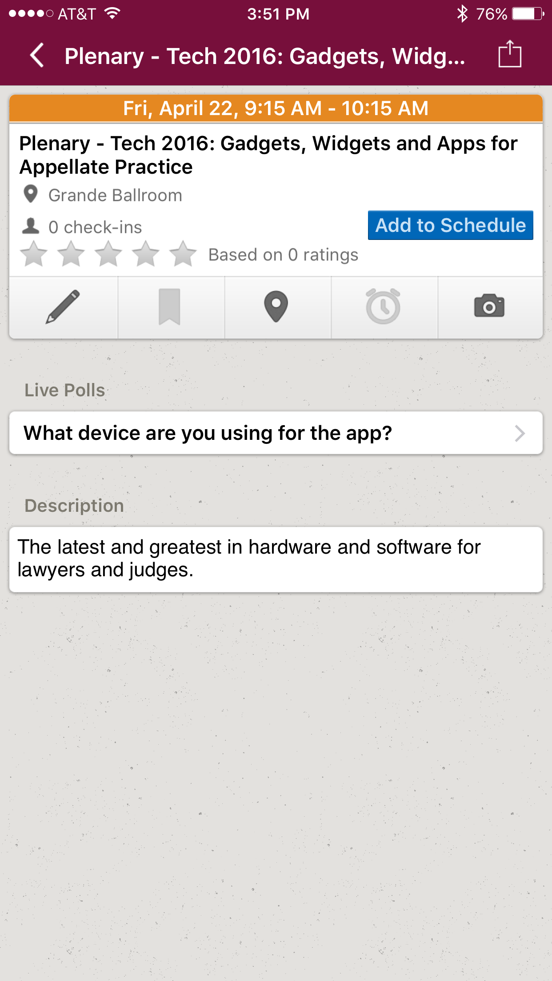
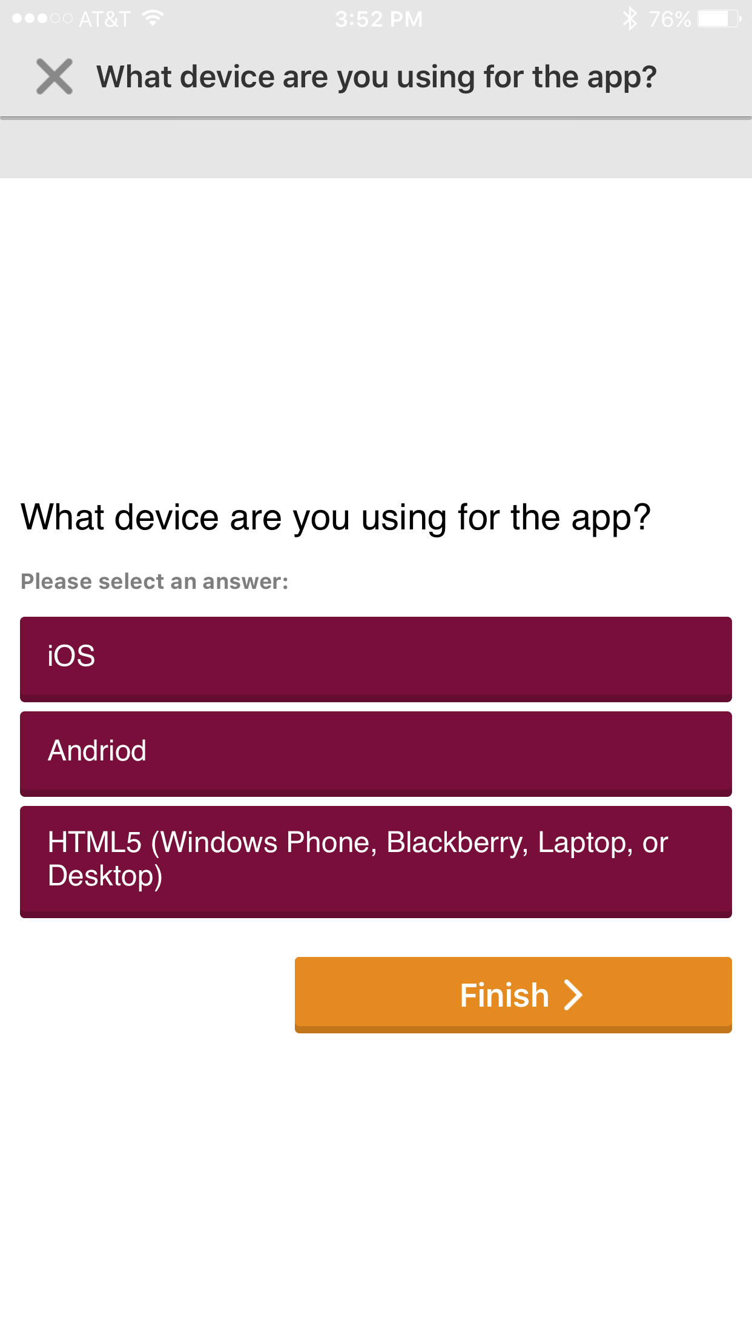
Live Polling
1 Access Schedule on the Event Guide.
2 In the schedule go to the session/plenary being attended. The top navigation will show which day of the schedule is being viewed. Scroll through until finding the session/plenary you are attending. (Easy access to your personal schedule is on the bottom navigation bar.) 3 View the session/plenary page and find the Live Polls area. Click on the poll that is being asked.
4 Select an answer and click Finish.

Slide 5
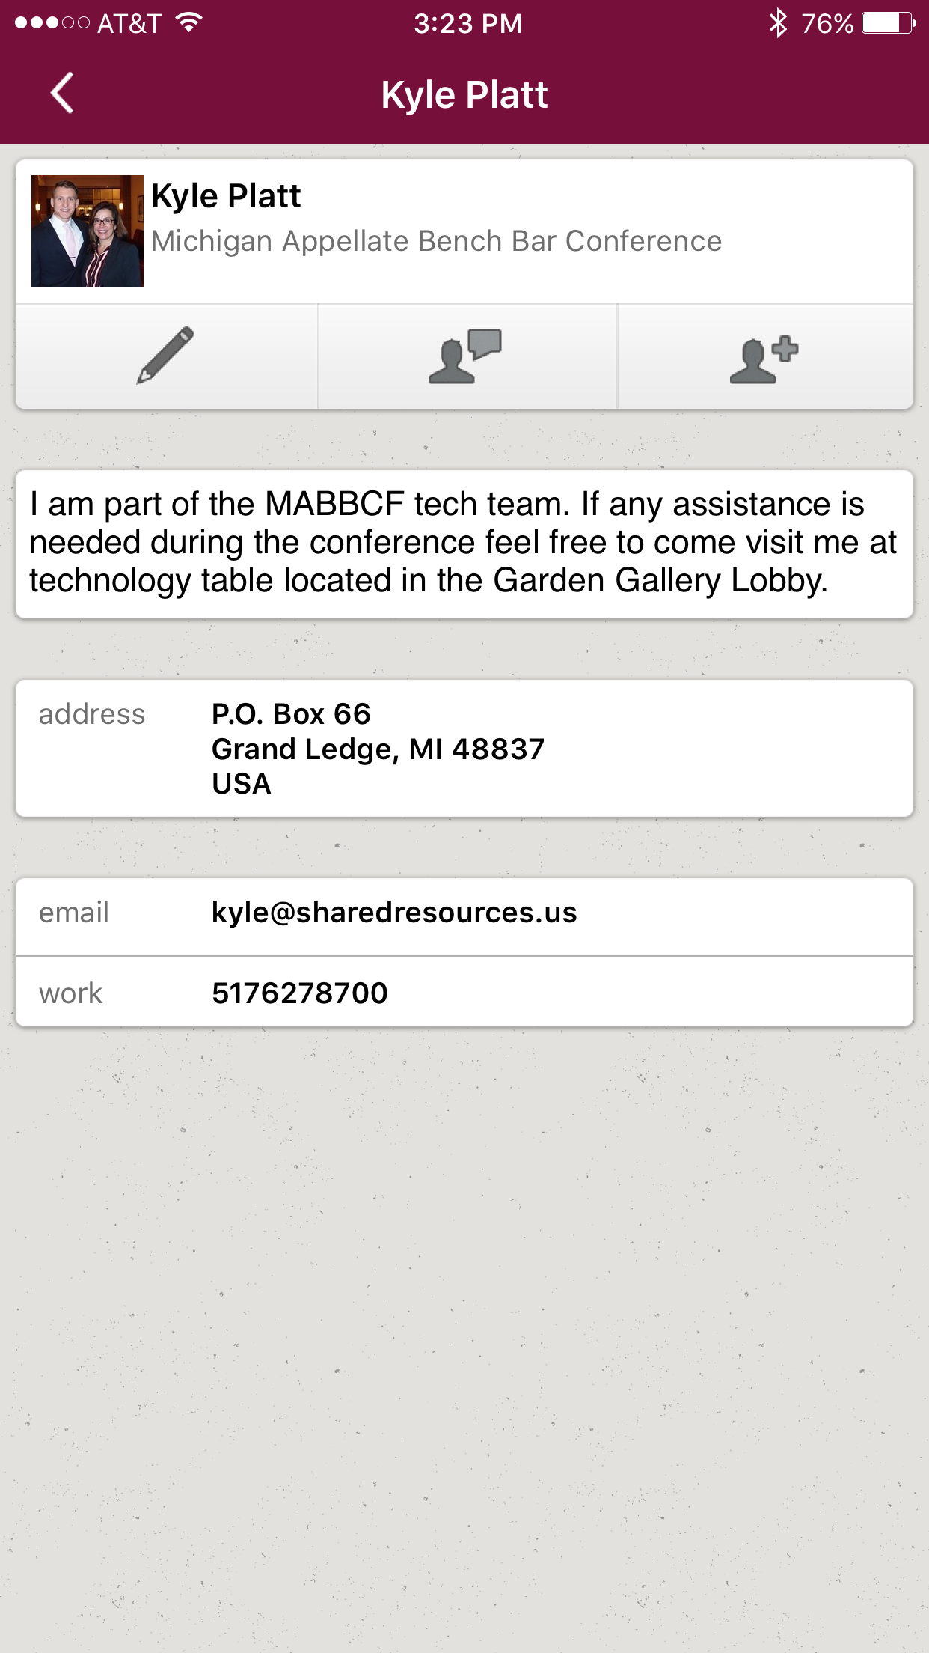
Messaging Attendees
Get to Chatting
1 Access the Attendee List. After logging in, tap the Attendees icon.
2 Send your message. Find the person you want to message by either scrolling through the list or using the search bar at the top of the screen.
Tap their name, then the chat icon to start texting. If you want to pick up a chat you previously started, tap the hamburger icon in the top right, then My Messages.
Or Be a Hermit
1 Access the Attendee List. Rather focus on the conference? Just as before, log in and tap the Attendees icon.
2 Block the person. Find the Chatty Cathy you’re worried about by scrolling through the list or using the search bar at the top of the screen. Tap their name, then the chat icon. But, don’t type anything, instead tap Block in the top right.

Slide 6
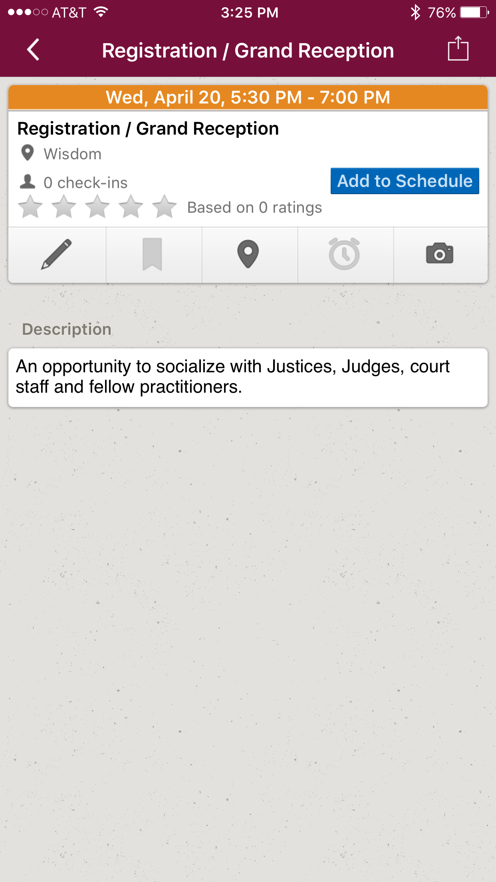
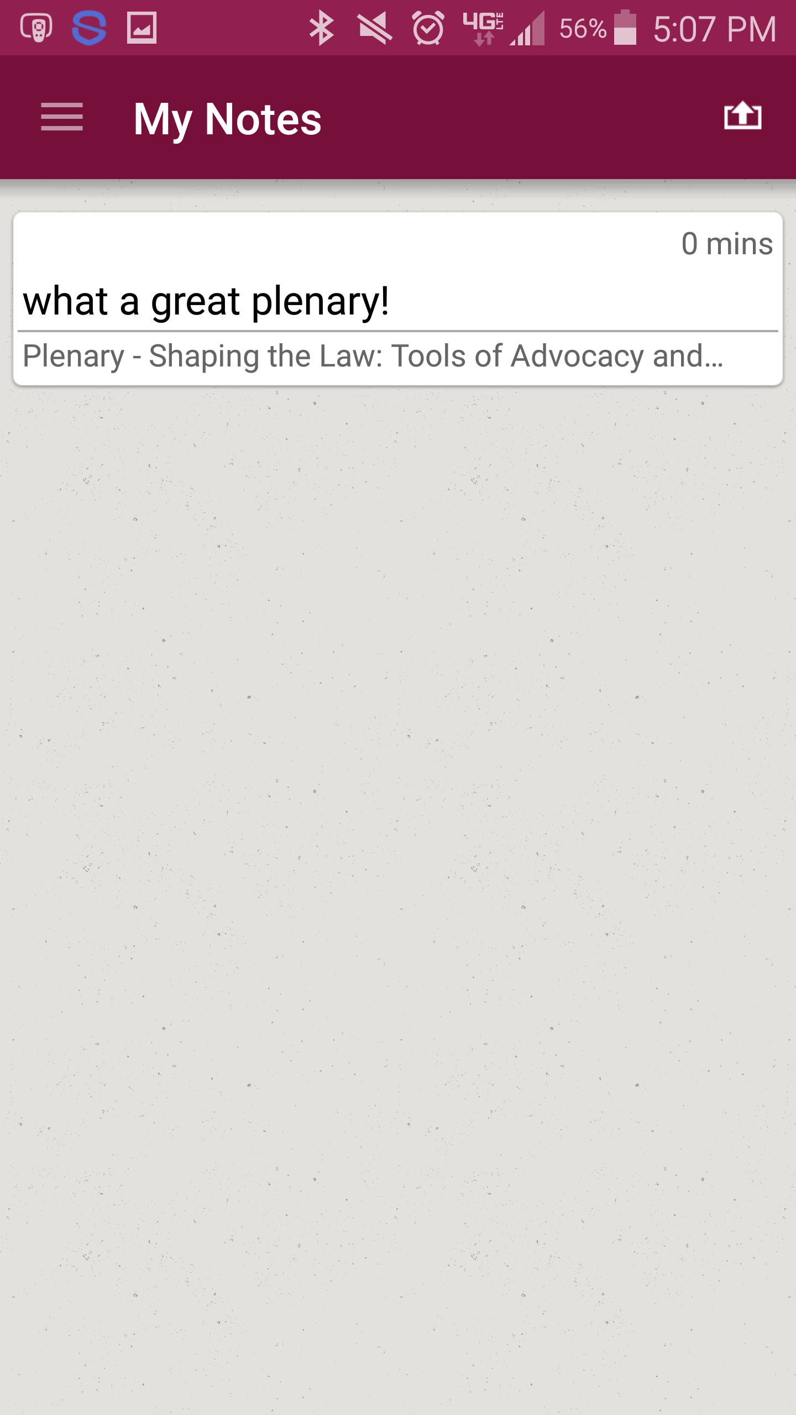
Creating Notes
Write Your Thoughts
1 Find your Event Item. After logging in, find the session, moderator/facilitator, or attendee you'd like to create a note about by tapping on the appropriate icon in the Event Directory, then scrolling through the item list. Once you've found the item you're looking for, tap on it..
2 Write your note. Tap the pencil icon to bring up a blank page and your keyboard. Enter your thoughts, observations, and ideas. Tap Done when you've finished.
Then Export Them
1 Navigate to My Notes. Tap the hamburger icon in the top right, then My Notes.
Here you’ll find all the notes you’ve taken organized by session.
2 Choose where to send your notes. Tap the share icon in the top right and we will automatically generate a draft of an email that contains all your notes. All you have to do is enter an email address, then tap Send.

Slide 7
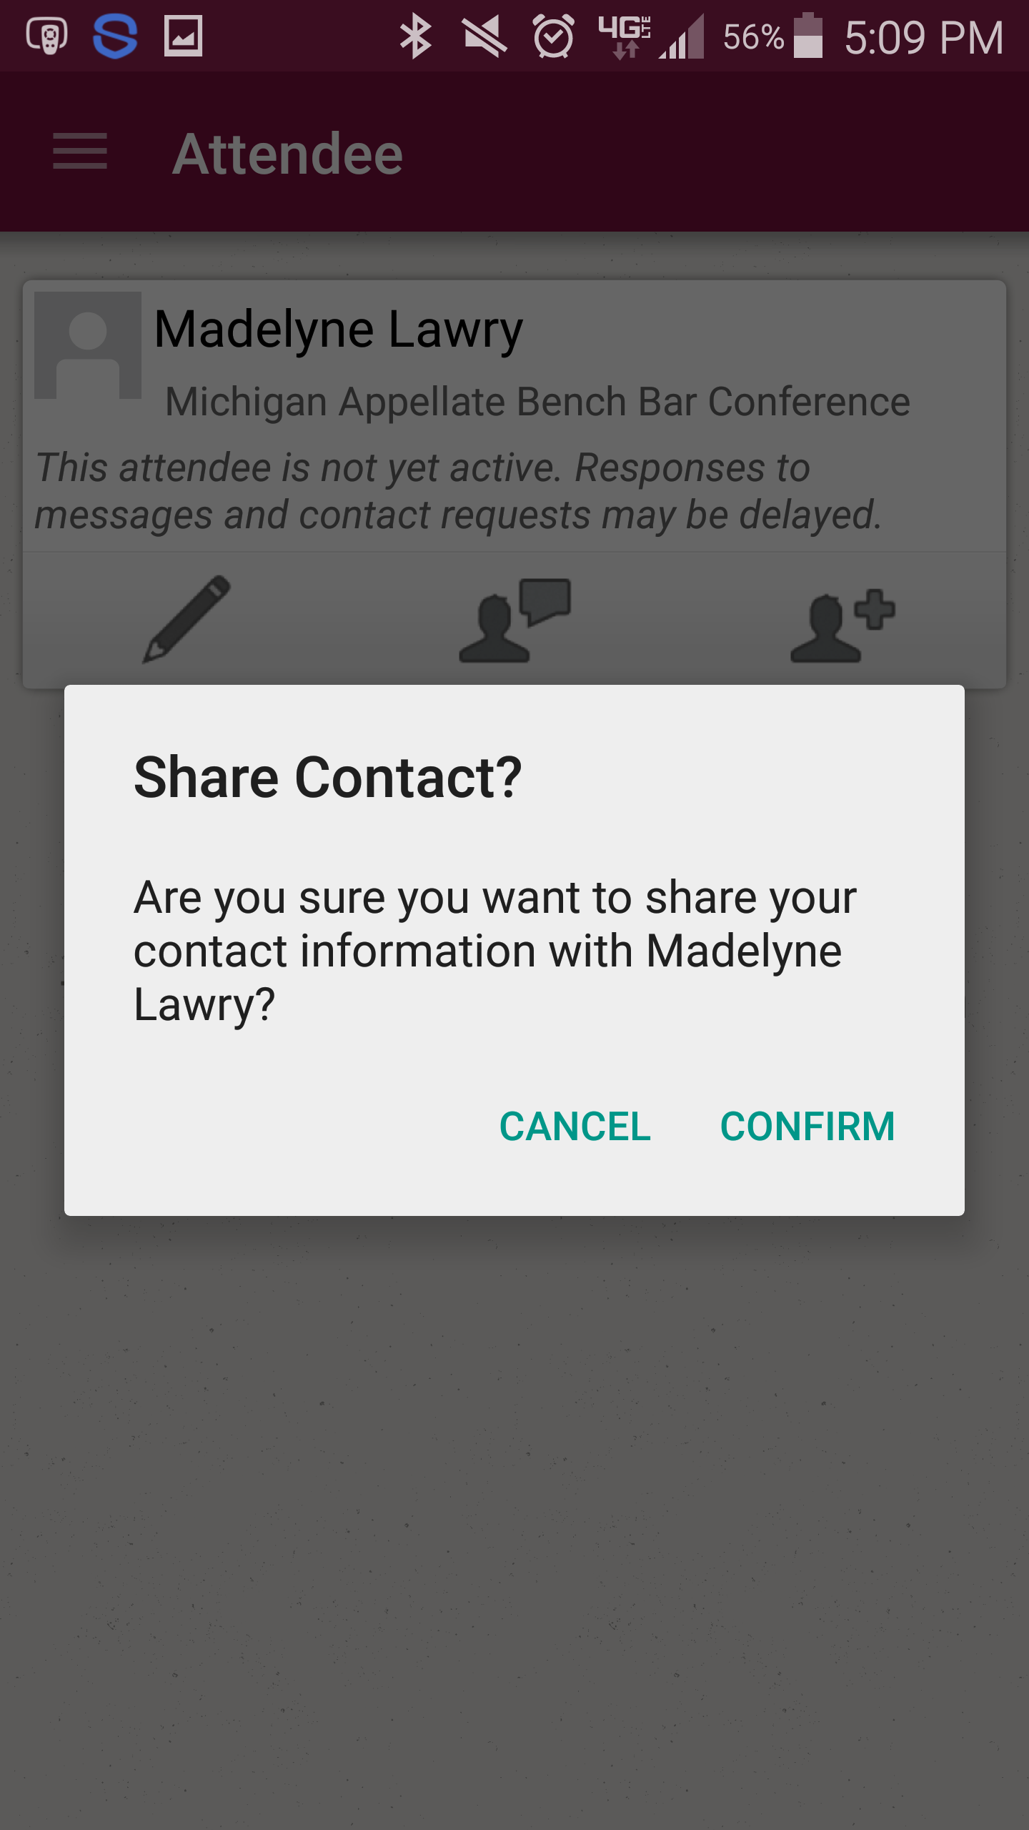
Networking
Share Your Info
1 Access the Attendee List. After logging in, tap the Attendees icon.
2 Send a request. Find the person you want to share your contact information by either scrolling through the list or using the search bar at the top of the screen.
Tap their name, then the plus icon to send a contact request. If they accept, the two of you will exchange info.
Continue the Convo
1 Access My Contacts. Tap the hamburger icon to open up the side nav, then My Contacts. Here you’ll find a list of all the attendees you’ve exchanged contact info with.
2 Connect outside the app. Find that interesting person you just met and tap their name.
You’ll be taken to a page that shows all the social networks that attendee has linked to their account. Tap any of their logos to connect to that attendee’s page.

Slide 8
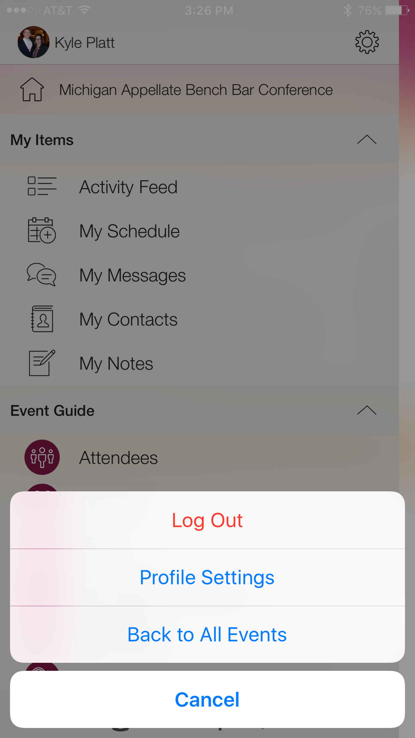
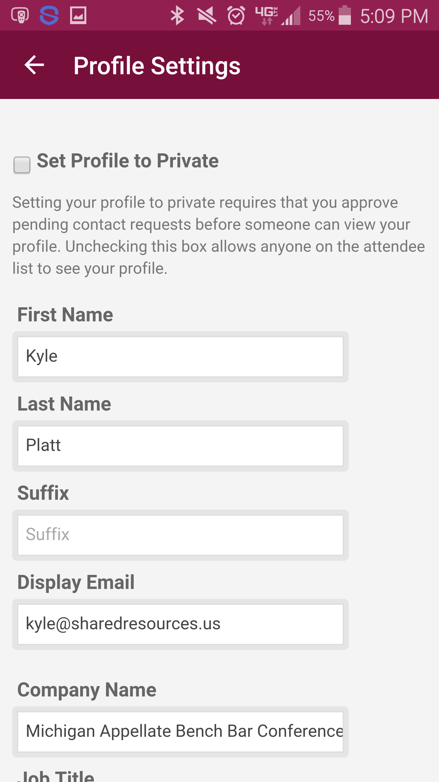
Marketing Yourself
Build Your Profile
1 Access your profile settings. After logging in, tap the hamburger icon in the top left, then tap your name at the top of the screen.
2 Tell us about you. Fill out the text fields to give other attendees a sense of who you are. You can write a short bio, provide your contact information, or direct people to your website or social media accounts.
Take it Public
1 Access your profile settings. If you don’t mind fellow attendees seeing your profile, you can set it to public.
After logging in, tap the hamburger icon in the top left, then tap your name at the top of the screen.
2 Uncheck the box. At the top of your Profile Settings, make sure that the box marked “Set Profile to Private” is unchecked.

Slide 9
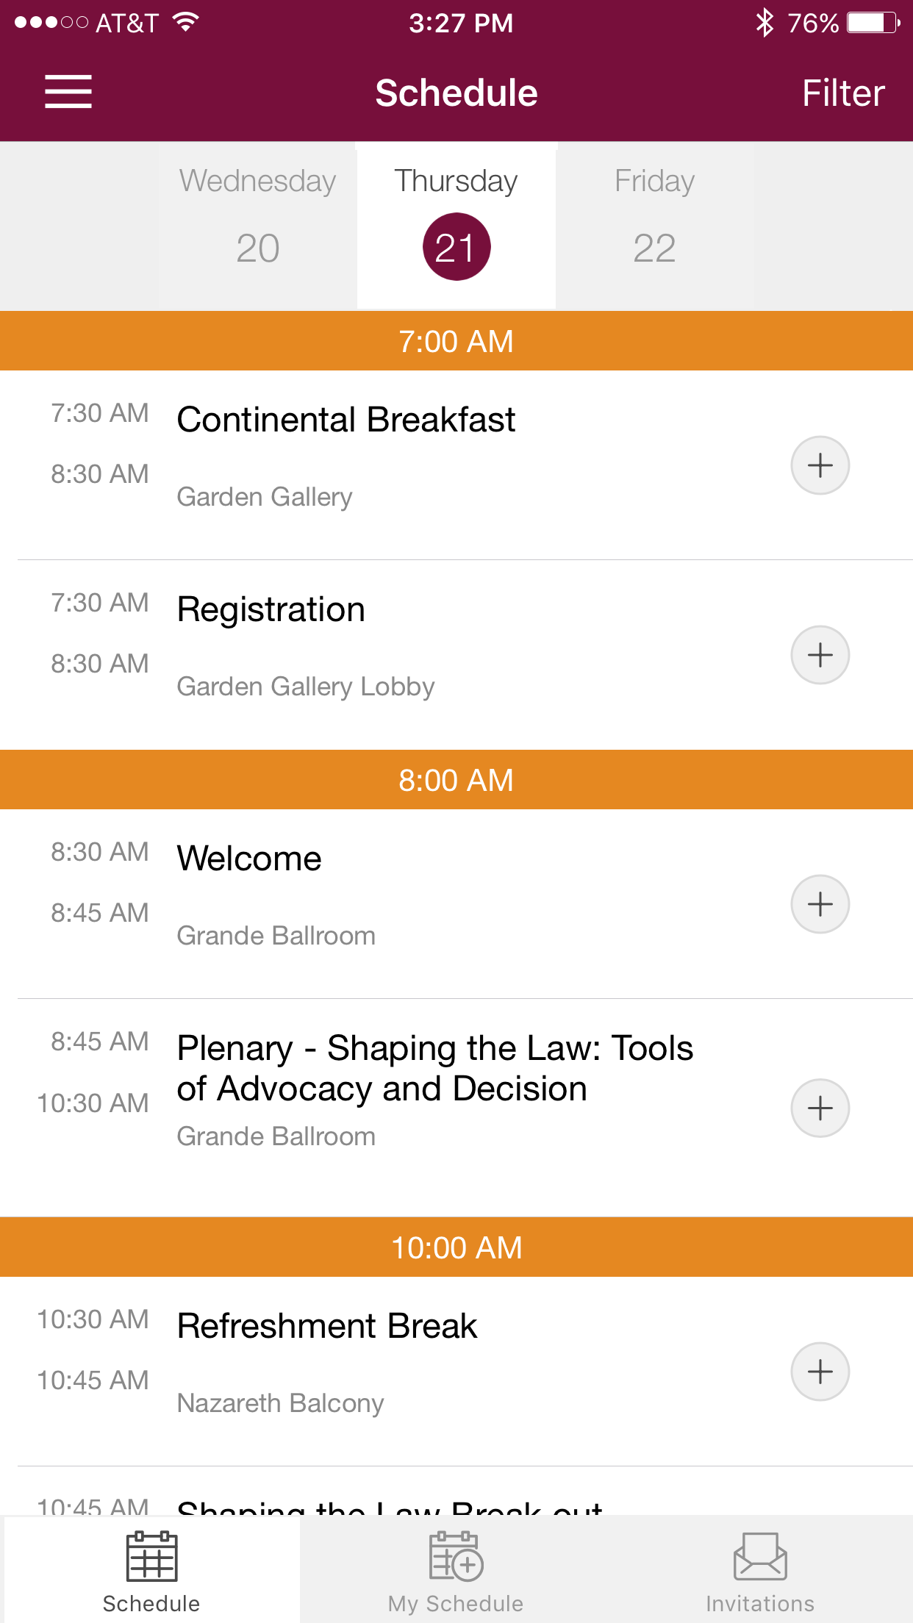
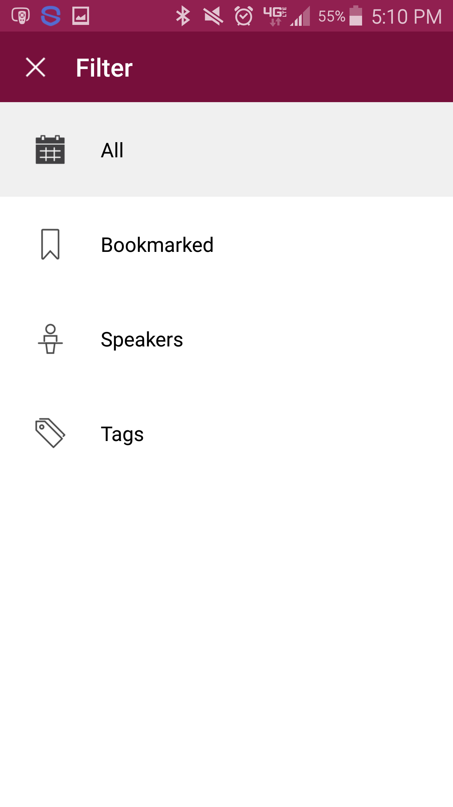
Navigating the Schedule
Browse Around
1 Open the Schedule. After logging in, tap the Schedule icon. 2 Browse the Calendar. Switch days by using the date selector at the top of the screen. Scroll up and down to see all the sessions on a particular day.
Or Filter and Search
1 Access the filter. Pick and choose what your schedule displays by tapping Filter in the top right corner of the screen.
2 Search for your content. You'll see a list of different types of content. Select one to filter by bookmarked sessions, tracks, and tags.

Slide 10
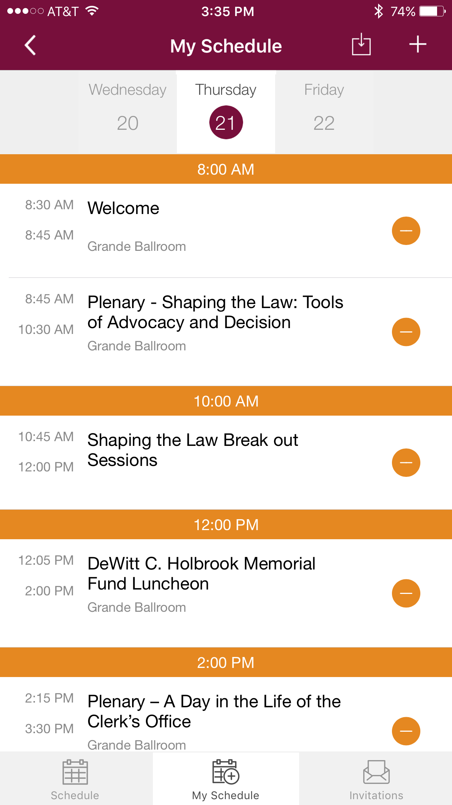
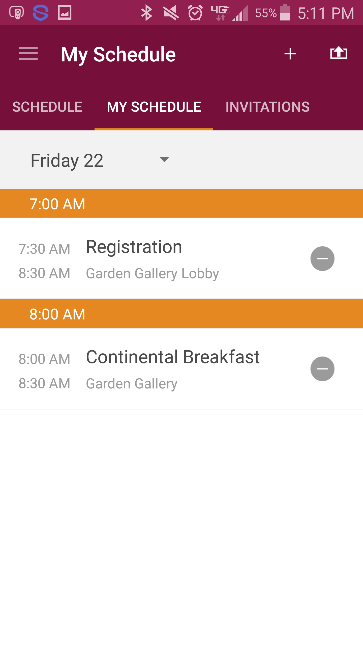
Exporting Your Schedule
Export in the App
1 Access your schedule. After logging in, tap the hamburger icon in the top right, then My Schedule.
Here you’ll see a personalized calendar of the sessions you’ll be attending. You can tap a session to see more details.
2 Export it. Tap the download icon at the top right of the screen. A confirmation screen will appear. Tap Export and your schedule will be added directly to your device’s calendar.

